Slide 1
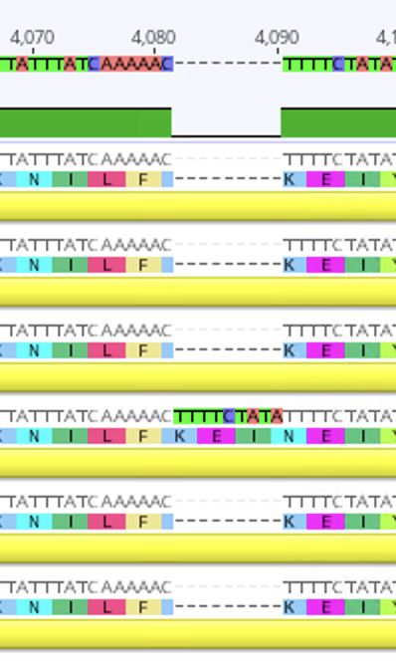
Figure S1
Average ND: 0.000727
1
200
400
600
800
1,000
1,200
1,400
1,600
1,800
2,000
2,200
2,400
2,600
2,800
3,000
3,200
3,400
3,600
3,800
4,000
4,200
4,400
4,632
ycf1 CDS
ycf1 CDS
ycf1 CDS
ycf1 CDS
ycf1 CDS
ycf1 CDS

Slide 2
Supplementary Fig.1. Nucleotide diversity of ycf1 in the six Agrinonia chloroplast genomes X-axis presents coordination of chloroplast genome and Y-axis presents values of nucleotide diversity value of 500-bp window sliding by 200-bp step displaying ycf1 genic regions. Below X-axis, positions of sequence variations identified in ycf1 were presented as black lines in the six grey bars, corresponding to the six Agrinonia chloroplast genomes. Blue-colored circles under the gene diagram means synonymous SNPs and orange-colored circles indicate non-synonymous SNPs. INDEL was depicted as blue-colored triangle.

